Slide 1

WORLD WIDE ENERGY CONSUMPTION
D.Dadapeer
K.Vaishnavi

Slide 2

AGENDA (This should be the PPT flow)
What is Energy and Sources of Energy.
Objective of the Project or Problem Statement
ER Diagram and schema explanation
Key analysis questions (use cases)
SQL query results with screenshots or summaries
Final business insights and recommendations
Conclusion (Key finding overall)

Slide 3
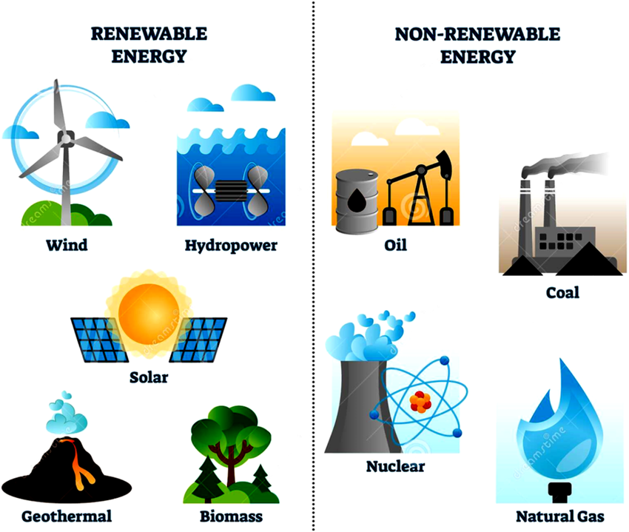
ENERGY
Energy is the capacity to do work. It exists in various forms, like heat, light, potential, and kinetic energy
SOURCES OF ENERGY
Renewable Energy Sources
Non-Renewable Energy Sources
1. Renewable Energy Sources
These are naturally replenished and sustainable.
☀️ Solar Energy
🌬️ Wind Energy
💧 Hydropower (Hydroelectric Energy)
🌿 Biomass Energy
🌋 Geothermal Energy
2. Non-Renewable Energy Sources
These are limited and will eventually run out.
🪨 Coal
🛢️ Crude Oil (Petroleum)
🔥 Natural Gas
☢️ Nuclear Energy (Uranium)

Slide 4

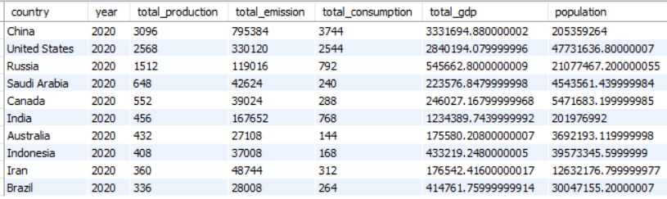
OBJECTIVE OF THE ANALYSIS
The primary objective of this analysis is to gain deep insights into global energy usage, production, emissions, population growth, and economic performance (GDP) by country and year. The key goals include:
Analyzing the relationship between energy production/consumption and emissions.
Identifying top contributors to emissions and trends over time.
Evaluating GDP and population growth impacts on energy demand and emissions.
Comparing per capita metrics and identifying major economies’ energy behavior.
Measuring the efficiency of energy usage relative to economic output.
Highlighting global emission shares, and identifying countries with positive or negative trends.
Supporting sustainable energy policy recommendations based on data-driven findings.

Slide 5
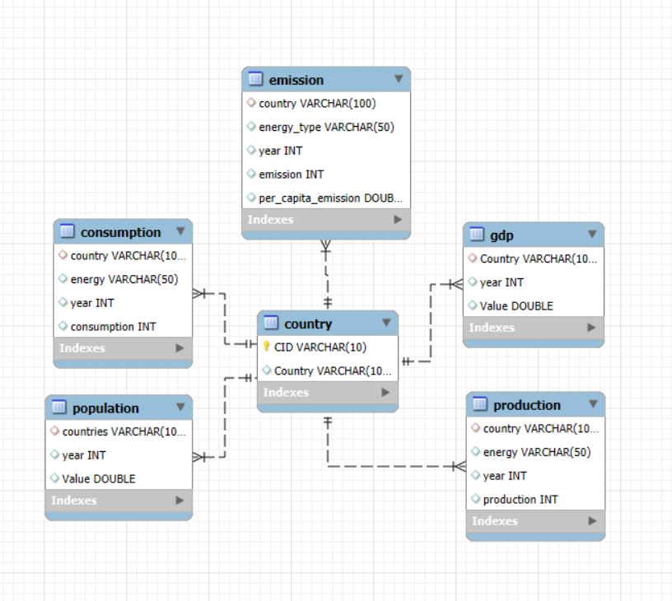
ER- DIAGRAM

Slide 6
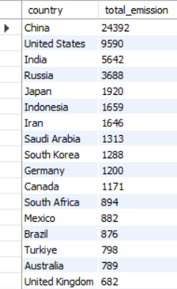
1. WHAT IS THE TOTAL EMISSION PER COUNTRY FOR THE MOST RECENT YEAR AVAILABLE?
SELECT COUNTRY, SUM(EMISSION) AS TOTAL_EMISSION
FROM EMISSION
WHERE YEAR = (SELECT MAX(YEAR) AS RECENT_YEAR FROM EMISSION)
GROUP BY COUNTRY
ORDER BY TOTAL_EMISSION DESC;

Slide 7
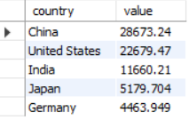
2. WHAT ARE THE TOP 5 COUNTRIES BY GDP IN THE MOST RECENT YEAR?
SELECT COUNTRY, VALUE
FROM GDP
WHERE YEAR = (SELECT MAX(YEAR) FROM GDP)
ORDER BY VALUE DESC
LIMIT 5;

Slide 8
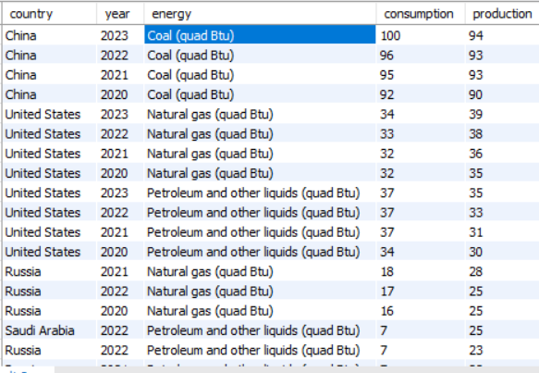
3.COMPARE ENERGY PRODUCTION AND CONSUMPTION BY COUNTRY AND YEAR.
SELECT
P.COUNTRY, P.YEAR,P.ENERGY, C.CONSUMPTION, P.PRODUCTION,
(C.CONSUMPTION-P.PRODUCTION) AS COMPARISON
FROM PRODUCTION P
JOIN CONSUMPTION C ON P.COUNTRY = C.COUNTRY AND P.YEAR = C.YEAR
AND P.ENERGY = C.ENERGY
ORDER BY PRODUCTION DESC;

Slide 9
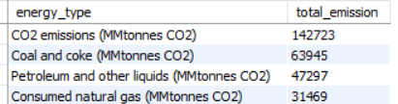
4.WHICH ENERGY TYPES CONTRIBUTE MOST TO EMISSIONS ACROSS ALL COUNTRIES?
SELECT ENERGY_TYPE, SUM(EMISSION) AS TOTAL_EMISSION
FROM EMISSION
GROUP BY ENERGY_TYPE
ORDER BY TOTAL_EMISSION DESC;

Slide 10
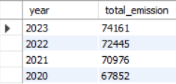
Trend Analysis Over Time:
5. HOW HAVE GLOBAL EMISSIONS CHANGED YEAR OVER YEAR?
SELECT
YEAR, SUM(EMISSION)
FROM EMISSION
GROUP BY YEAR
ORDER BY YEAR DESC;

Slide 11
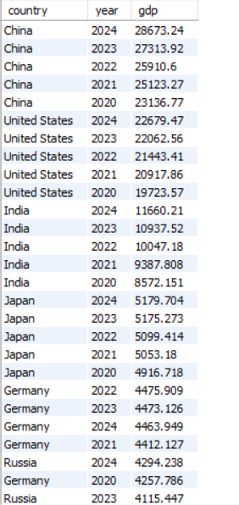
6.WHAT IS THE TREND IN GDP FOR EACH COUNTRY OVER THE GIVEN YEARS?
SELECT
COUNTRY, YEAR, VALUE AS GDP
FROM GDP
ORDER BY COUNTRY , YEAR;

Slide 12
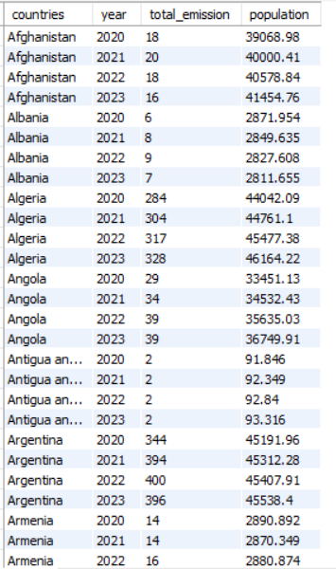
7. HOW HAS POPULATION GROWTH AFFECTED TOTAL EMISSIONS IN EACH COUNTRY?
SELECT P.COUNTRIES, P.YEAR,
SUM(E.EMISSION) AS TOTAL_EMISSION,
P.VALUE AS POPULATION
FROM POPULATION P JOIN EMISSION E
ON P.COUNTRIES = E.COUNTRY
AND P.YEAR = E.YEAR
GROUP BY P.COUNTRIES , P.YEAR , P.VALUE
ORDER BY COUNTRIES , YEAR;

Slide 13
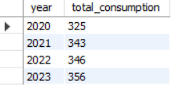
8. HAS ENERGY CONSUMPTION INCREASED OR DECREASED OVER THE YEARS FOR MAJOR ECONOMIES?
SELECT C.YEAR, SUM(C.CONSUMPTION) AS TOTAL_CONSUMPTION
FROM
CONSUMPTION C JOIN
(SELECT COUNTRY, SUM(VALUE) AS TOTAL_GDP FROM GDP
GROUP BY COUNTRY
ORDER BY TOTAL_GDP DESC
LIMIT 5) AS MAJOR_ECONOMIES ON C.COUNTRY = MAJOR_ECONOMIES.COUNTRY
GROUP BY C.YEAR
ORDER BY C.YEAR;

Slide 14
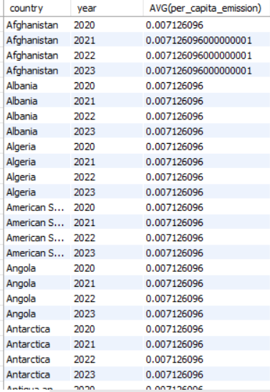
9.WHAT IS THE AVERAGE YEARLY CHANGE IN EMISSIONS PER CAPITA FOR EACH COUNTRY?
WITH EMISSIONCHANGES
AS ( SELECT COUNTRY, YEAR, PER_CAPITA_EMISSION, LAG(PER_CAPITA_EMISSION) OVER(PARTITION BY COUNTRY ORDER BY YEAR) AS PRE_YEAR_EMISSION FROM EMISSION)
SELECT COUNTRY, ROUND(AVG(PER_CAPITA_EMISSION-PRE_YEAR_EMISSION),2) AS AVG_YEAR_PERCAPITA_CHANGE
FROM EMISSIONCHANGES WHERE PRE_YEAR_EMISSION IS NOT NULL
GROUP BY COUNTRY
ORDER BY AVG_YEAR_PERCAPITA_CHANGE DESC;

Slide 15
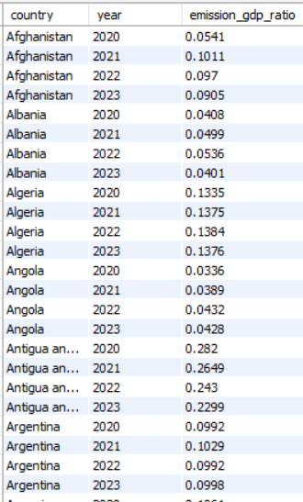
10. WHAT IS THE EMISSION-TO-GDP RATIO FOR EACH COUNTRY BY YEAR?
SELECT E.COUNTRY, E.YEAR, ROUND((SUM(E.EMISSION) / SUM(G.VALUE)), 4) AS RATIO
FROM EMISSION E JOIN GDP G ON E.COUNTRY = G.COUNTRY
AND E.YEAR = G.YEAR
GROUP BY COUNTRY , YEAR
ORDER BY COUNTRY , YEAR;

Slide 16
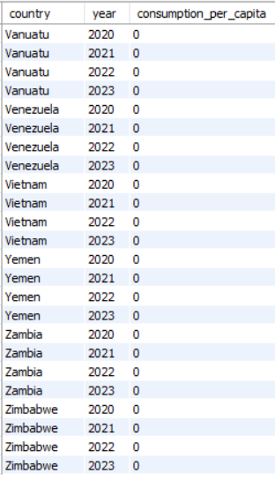
11.WHAT IS THE ENERGY CONSUMPTION PER CAPITA FOR EACH COUNTRY OVER THE LAST DECADE?
WITH RECENT_YEARS AS
(SELECT MAX(YEAR) AS MAX_YEAR FROM CONSUMPTION),
CONSUMPTION_DATA AS
(SELECT C.COUNTRY, C.YEAR, C.CONSUMPTION, P.VALUE AS POPULATION
FROM CONSUMPTION C JOIN POPULATION P
ON C.COUNTRY = P.COUNTRIES AND C.YEAR = P.YEAR WHERE C.YEAR >= (SELECT MAX_YEAR - 9 FROM RECENT_YEARS)
SELECT COUNTRY, YEAR, ROUND(SUM(CONSUMPTION) / SUM(POPULATION), 4) AS CONSUMPTION_PER_CAPITA
FROM CONSUMPTION_DATA
GROUP BY COUNTRY, YEAR
ORDER BY COUNTRY,YEAR;

Slide 17
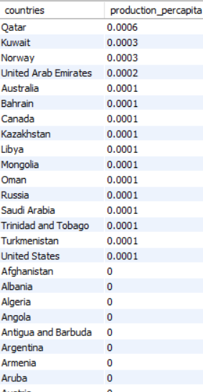
12.HOW DOES ENERGY PRODUCTION PER CAPITA VARY ACROSS COUNTRIES
SELECT P.COUNTRIES, ROUND(SUM(P1.PRODUCTION) / SUM(P.VALUE), 4)
AS PRODUCTION_PERCAPITA
FROM
POPULATION P
JOIN PRODUCTION P1
ON P.COUNTRIES = P1.COUNTRY
AND P.YEAR = P1.YEAR
GROUP BY P.COUNTRIES
ORDER BY PRODUCTION_PERCAPITA DESC;

Slide 18
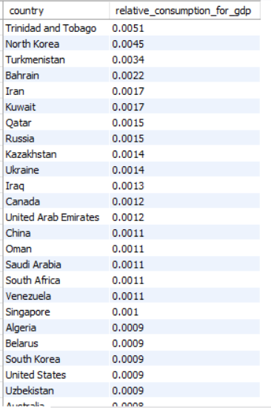
13.WHICH COUNTRIES HAVE THE HIGHEST ENERGY CONSUMPTION RELATIVE TO GDP?
SELECT C.COUNTRY,
ROUND(SUM(CONSUMPTION) / SUM(G.VALUE), 4)
AS RELATIVE_CONSUMPTION_FOR_GDP
FROM CONSUMPTION C
JOIN GDP G
ON C.COUNTRY = G.COUNTRY
AND C.YEAR = G.YEAR
GROUP BY COUNTRY
ORDER BY RELATIVE_CONSUMPTION_FOR_GDP DESC;

Slide 19
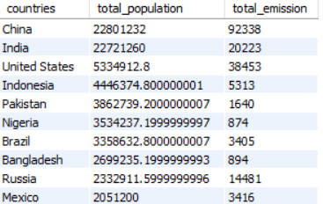
GLOBAL COMPARISONS:
14. WHAT ARE THE TOP 10 COUNTRIES BY POPULATION AND HOW DO THEIR EMISSIONS COMPARE?
SELECT P.COUNTRIES,
SUM(P.VALUE) AS TOTAL_POPULATION, SUM(E.EMISSION) AS TOTAL_EMISSION
FROM POPULATION P
JOIN EMISSION E
ON P.COUNTRIES = E.COUNTRY
AND P.YEAR = E.YEAR
GROUP BY P.COUNTRIES
ORDER BY TOTAL_POPULATION DESC
LIMIT 10;

Slide 20
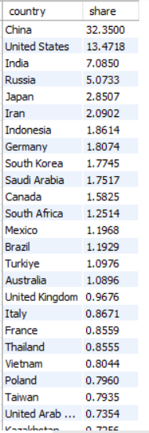
15. WHAT IS THE GLOBAL SHARE (%) OF EMISSIONS BY COUNTRY?
WITH TOTAL_EMISSION_PER_COUNTRY AS
(SELECT COUNTRY, SUM(EMISSION) AS TOTAL_EMISSION
FROM EMISSION
GROUP BY COUNTRY)
SELECT COUNTRY, ROUND(TOTAL_EMISSION*100/(SELECT SUM(EMISSION) FROM EMISSION),5)
AS SHARE
FROM TOTAL_EMISSION_PER_COUNTRY
ORDER BY SHARE DESC;

Slide 21
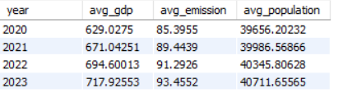
16. WHAT IS THE GLOBAL AVERAGE GDP, EMISSION, AND POPULATION BY YEAR?
SELECT E.YEAR,
ROUND(AVG(G.VALUE), 5) AS AVG_GDP, ROUND(AVG(E.EMISSION), 5) AS AVG_EMISSION,
ROUND(AVG(P.VALUE), 5) AS AVG_POPULATION
FROM EMISSION E JOIN GDP G
ON E.COUNTRY = G.COUNTRY
AND E.YEAR = G.YEAR
JOIN POPULATION P
ON P.COUNTRIES = E.COUNTRY
AND P.YEAR = E.YEAR
GROUP BY E.YEAR
ORDER BY E.YEAR;

Slide 22
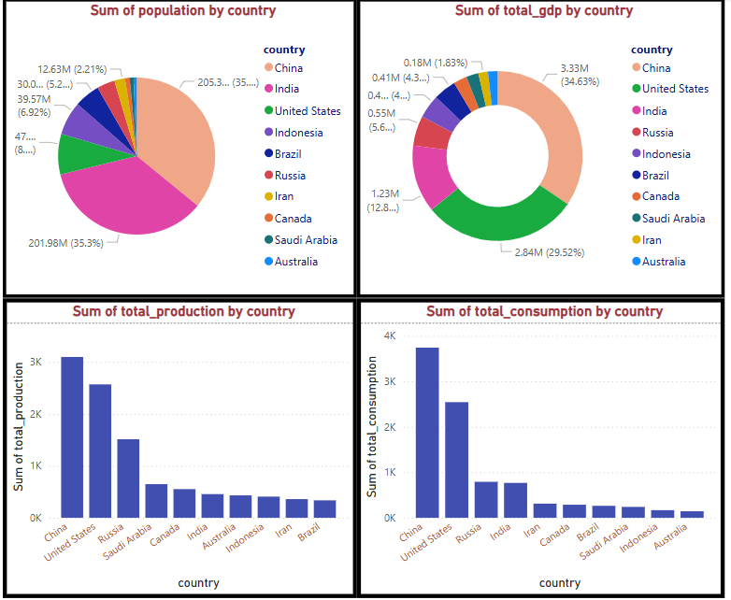
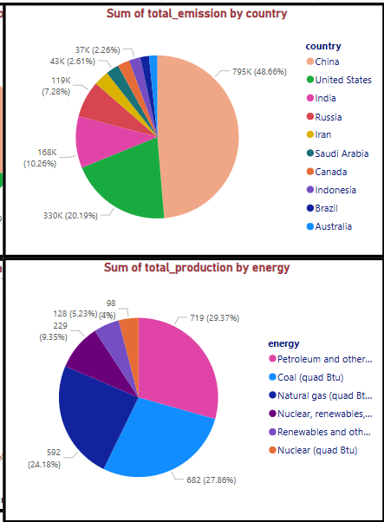
GRAPHICAL REPRASENTATION

Slide 23
CONCLUSIONS
Top Emitting Countries: Nations like China, the USA, and India consistently rank highest in total emissions due to their large populations and industrial energy demands.
High Emission Energy Types: Fossil fuels (especially coal and oil) are the primary contributors to global emissions, highlighting the urgent need for cleaner alternatives.
Per Capita Insights: Some countries have high total emissions but low per capita emissions due to large populations. Others, mainly developed nations, show higher per capita emissions, though several have reduced theirs over the past decade.
Energy Production vs. Consumption: Countries like the USA and China show both high production and consumption, while others consume more than they produce, relying on imports.
Energy Efficiency: Countries with lower emission-to-GDP and consumption-to-GDP ratios demonstrate better energy efficiency, often due to cleaner energy policies and technologies.
Global Emission Distribution: A small number of countries account for a major share of global emissions, revealing uneven responsibility and opportunity for leadership in climate action.
Population Impact: Emissions generally rise with population growth, but countries that have invested in clean energy have successfully decoupled emissions from population increases.
Improvement Trends: Some countries have achieved significant reductions in per capita emissions over the last decade, showing that policy interventions and innovation are effective.
Global Averages: Yearly averages show gradual changes, with global GDP and energy demand increasing, while emissions per capita show mixed trends depending on the region

Slide 24

THANK YOU

